Slide 1

ALS-CLS :AUTONOMOUS LEAF SEGMENTATION IN COMPLICATED LIGHTING SITUATIONS
GUIDE
SRILAKSHMI A
Asst. Professor II
school of computing
PRESENTED BY
125003035 - Obili Arshiya
125015113 - Shalini Ravi
125003227- Kappeta Poojitha

Slide 2
Agenda
Base paper details
Problem Statement
Abstract
Literature Survey
Existing Systems
Drawbacks of Existing Systems
Proposed Systems
Datasets
Modules
Architecture
Timeline
Workplan
Conclusion
References

Slide 3
Base paper Details
Title of the base paper : Self-Supervised Leaf Segmentation under complex lighting situation
Name of the Journal : Pattern Recognition
Indexing : ScienceDirect
Impact factor of Journal : 8.518
Year of publication : 2022
Link of the Base paper : https://www.sciencedirect.com/science/article/pii/S0031320322005015

Slide 4
PROBLEM STATEMENT:
The challenge of accurately identifying and separating leaf regions from background in images where lighting conditions are complex. The goal is to achieve accurate and reliable leaf segmentation to facilitate further analysis such as disease detection, species identification etc.

Slide 5
Abstract
Leaf segmentation is a key precondition for image-based plant phenotyping.
Self-supervised learning's applicability to image-based plant phenotyping is under-studied.
The segmentation followed by the model is Category level segmentation.

Slide 6
LITERATURE SURVEY
YEAR
AUTHOR
RESEARCH TITLE
ARCHITECTURE
ACCURACY
2015 | Massimo Minervini et al,[6] | Finely-grained annotated datasets for image-based plant phenotyping | Symmetric Best Dice | 48.7%
 |  |  | DSC | 83.1%
2022 | Hongjie He et al,[13] | Mask R-CNN based automated identification and extraction of oil well sites | OWS Mask R-CNN | Pixel Accuracy-99.49%
 |  |  | D-Mask R-CNN | Pixel Accuracy-97.83%
 |  |  | Mask R-CNN | Pixel Accuracy-97.34%

Slide 7
LITERATURE SURVEY
YEAR | AUTHOR | RESEARCH TITLE | ARCHITECTURE | ACCURACY
2015 | Olaf Ronneberger et al,[22] | Convolutional Networks for Biomedical Image Segmentation | U-Net | 77.5%
2011 | Philipp Krahenbuhl Et al,[42] | Efficient Interference in Fully Connected CRFs with Gaussian Edge Potentials | CRF | Average Segmentation Accuracy-30.2%
2019 | Mulham Fawakherji Et al,[23] | Crop and weeds classification for Precision Agriculture using Context-Independent Pixel-wise segmentation | VGG-16 Binary Classifier | Accuracy-90%

Slide 8
LITERATURE SURVEY
YEAR | AUTHOR | RESEARCH TITLE | ARCHITECTURE | ACCURACY
2019 | X Ji et al,[33] | Invariant Information clustering for Unsupervised image classification and segmentation | STL10 | Accuracy-88.8%
2022 | Xiaohan Yu et al,[31] | Self-supervised part erasing for ultra-fine-grained visual categorization | ResNet-50 | Accuracy-86.8%
2020 | Kunlong Yang et al,[24] | Leaf segmentation and classification with a complicated background using Deep Learning | VGG-16 (Mask R-CNN included) | Accuracy-91.5%

Slide 9
Existing Systems
• Focused on rosette plants, advancing research in image-based plant phenotyping. • Current methods mainly rely on supervised training of deep convolutional neural networks (CNNs), particularly U-Net and Mask-RCNN. •There have been many attempts to generate new synthetic data samples by 3D plant modeling , Generative Adversarial Networks (GANs) , domain randomization

Slide 10
Drawbacks of Existing System
• Deep model training requires large annotated data, which can be labor- intensive and error-prone. • Image-based plant phenotyping requires annotated data with diverse mutations, genotypes, and environmental conditions. • Deep learning models trained on specific plant species often don't generalize well to other species, especially for leaf segmentation. • Variations in lighting conditions, weather conditions, and times of the day add to the challenges of leaf segmentation. • Limited research exists on the effectiveness of leaf segmentation under different lighting conditions, especially in greenhouse cultivation.

Slide 11
Proposed Systems
• Presents a self-supervised leaf segmentation framework comprising a semantic segmentation model, The color-based leaf segmentation algorithm , and a self-supervised color correction model.
• The semantic segmentation model groups semantically similar pixels, allowing the same semantic object's pixels to be jointly considered by the algorithm.
• The self-supervised color correction model is proposed for images taken under complex illumination conditions.
• The algorithm uses color-based leaf segmentation to model semantic object greenness in an image, identifying regions with acceptable absolute and relative greenness as leaf regions.

Slide 12
Datasets
Two datasets are used:
Cannabis dataset or the CVVPP leaf segmentation challenge dataset
Each dataset contains multiple images captured under three different lighting conditions: "Natural", "Yellow", and "Purple", with many images obtained in each lighting condition.
https://drive.google.com/drive/folders/1tmaRUmdnDhyvnznOWD_S1sYkxb-g02MT

Slide 13
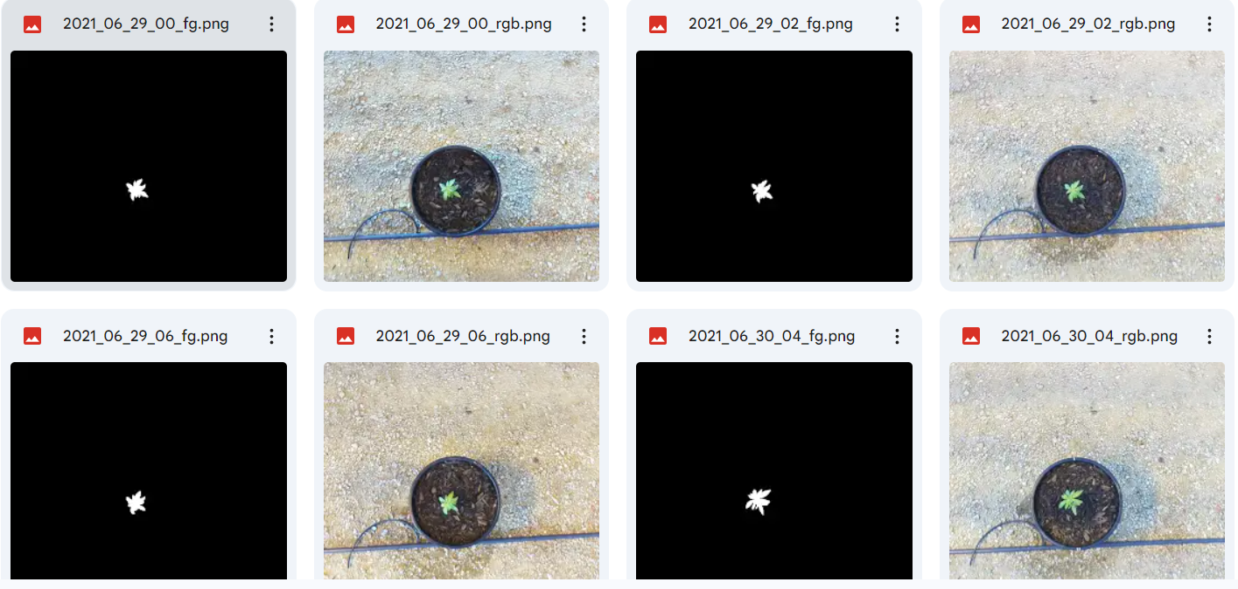
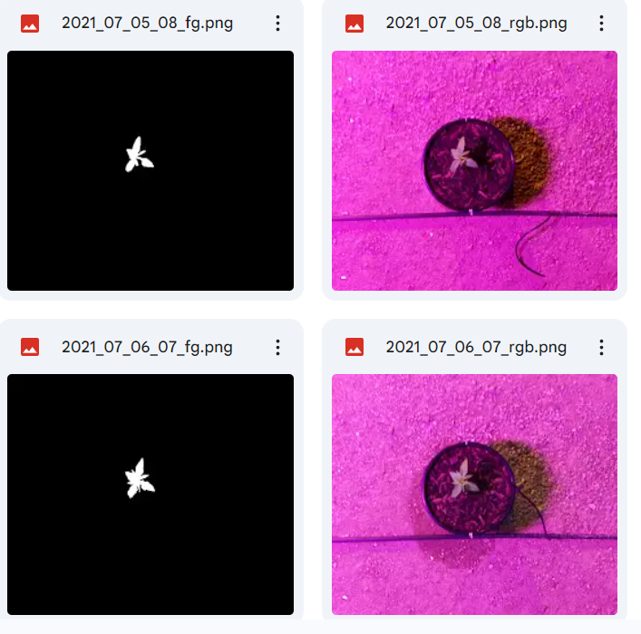
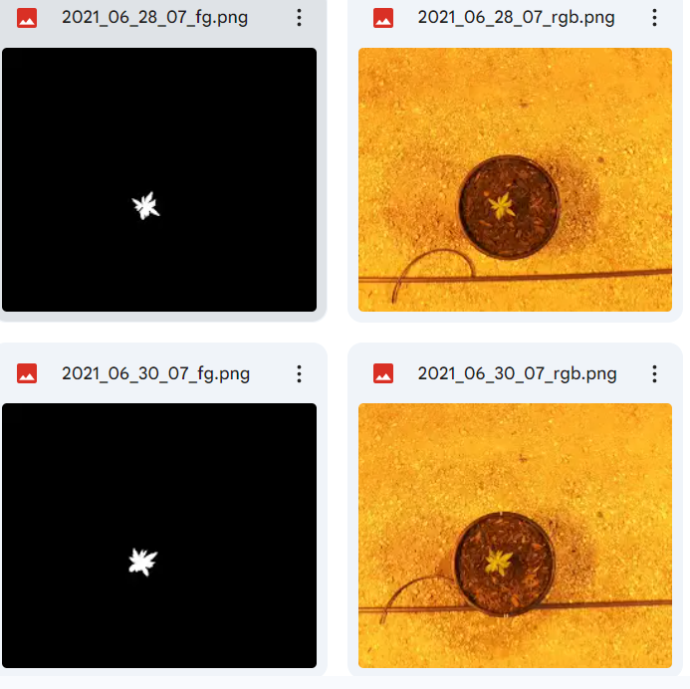
Cannabis dataset
Natural light
Purple light
Yellow light

Slide 14
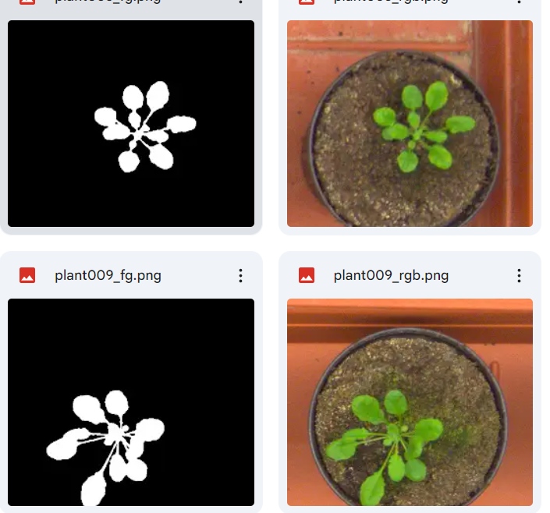
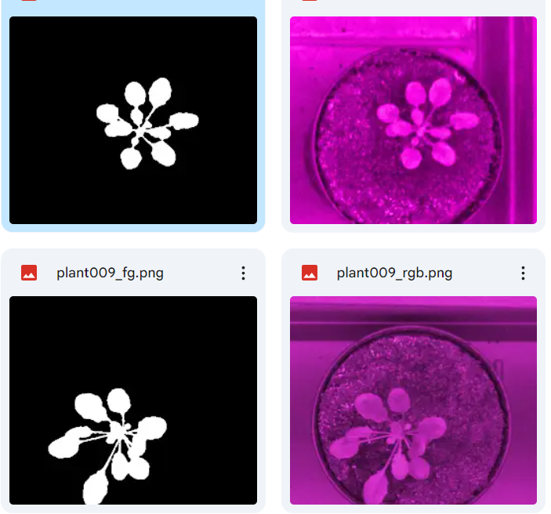
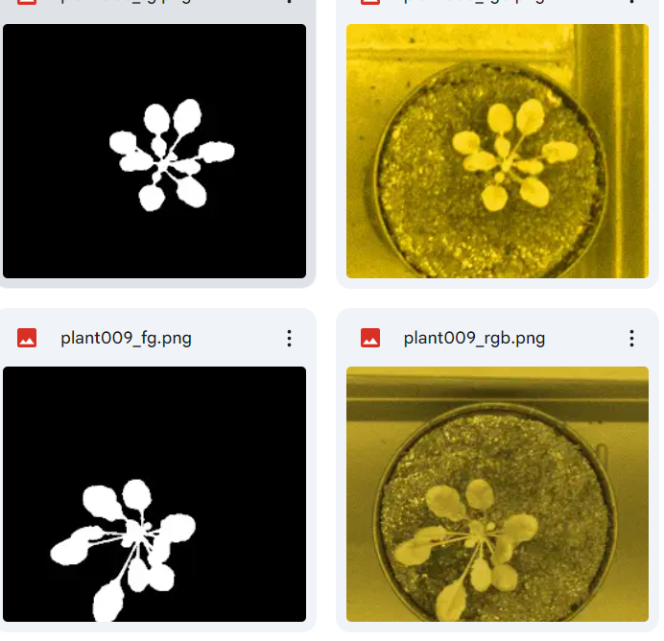
CVPPP dataset
Natural light
Purple light
Yellow light

Slide 15
Modules
Module 1 :
Color Correction
U-NET Architecture
Conv 3x3
Batch normal
ReLU Layer
Module 2 :
Self Supervised Semantic Segmentation
Conv 1x1
DW Conv 3x3
Batch normal
ReLU Layer
Softmax
Convolutional CRF
Argmax

Slide 16
Architecture Diagram
Self supervised Semantic segmentation
Color Correction
Input
3 x Repetition
Conv 1x1
U-NET ARCHITECTURE
Conv 3x3
Batch Normal
ReLU Layer
DW Conv 3x3
Training
Batch Normal
ReLU
Unlabeled Training Data
Softmax
Training
Discriminator D
Convolutional CRF
Pseudo Labels
Argmax
Cross Entropy Loss
Semantic Labels
Output
Color Based thresholding
Average colors

Slide 17
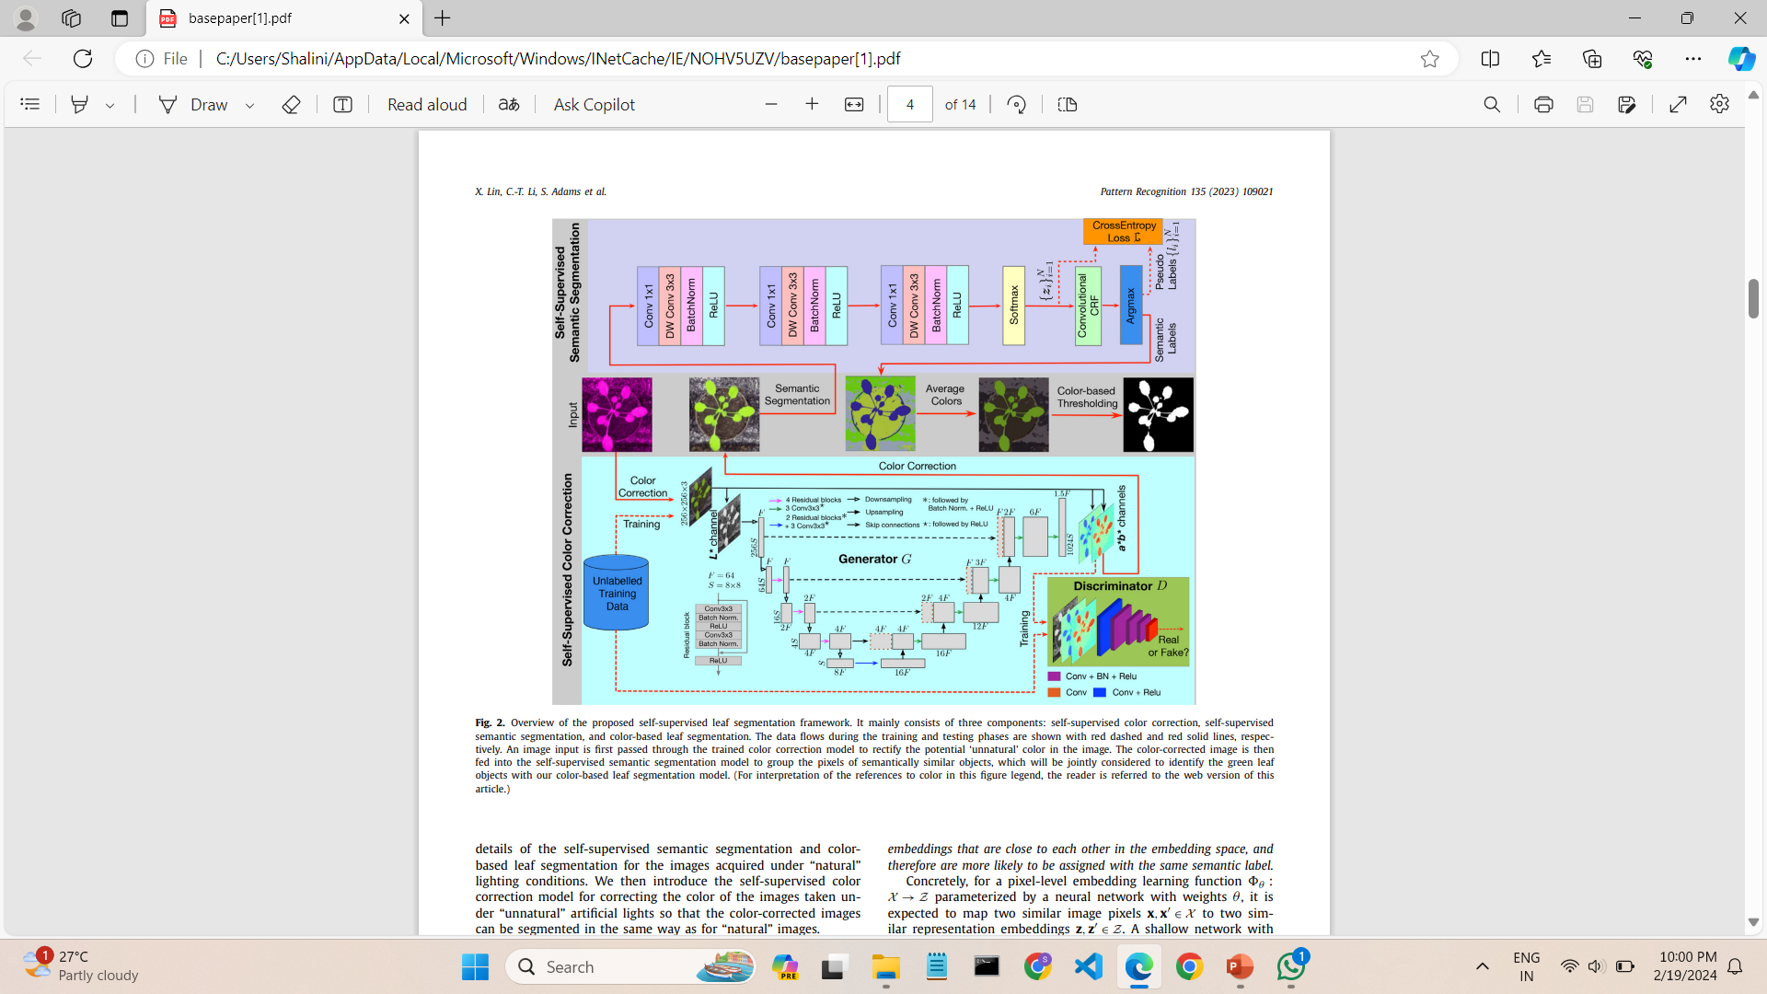

Slide 18
TIMELINE
Project selection and Abstract submission: Jan 30
Module1: Feb 1 to Mar 11
Understanding of project and downloading the test data: 1/2/24 – 4/2/24
Presentation of base paper is made : 13/2/24 – 15/2/24
Color correction for testing images : 25/2/24-27/2/24
Generator training and discriminator training : 1/3/24 – 8/3/24
Accuracy measures : 9/3/24- 11/3/24

Slide 19
TIMELINE
Module2 : Within Review 2
a*b* channels are given as input to module 2 to perform below mentioned operations:
Self Supervised Semantic Segmentation
Conv 1x1
DW Conv 3x3
Batch normal
ReLU Layer
Softmax
Argmax

Slide 20
Work Plan
This workflow demonstrates the training of a GAN-based model for color correction and image generation, primarily focused on leaf images. The generator learns to correct color deviations in the input images, and the discriminator helps ensure that the generated images look realistic.
Defined Generator and Discriminator Networks: Two neural networks: the generator and the discriminator.
Built Color Correction Model: A combined model is created, passing the generator's output to the discriminator for evaluation.
Defined Loss Functions: Mean squared error (MSE) loss for the generator and binary cross-entropy loss for the discriminator
Load and Preprocess Data: Training and testing images are loaded from specified directories.

Slide 21
Work Plan
Train Generator: The generator minimizes the difference between generated and original images.
Train Discriminator: The discriminator distinguishes between real and generated images.
Train Color Correction Model: The combined model is trained to generate corrected images while fooling the discriminator.
Apply Color Correction and Generate Images: Test images are loaded and passed through the process.
• Display Results: Original, corrected, and generated images are displayed using Matplotlib.

Slide 22
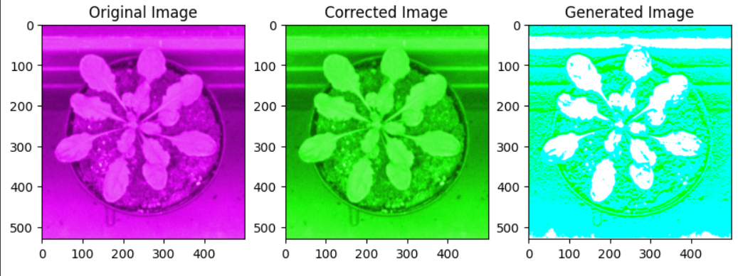
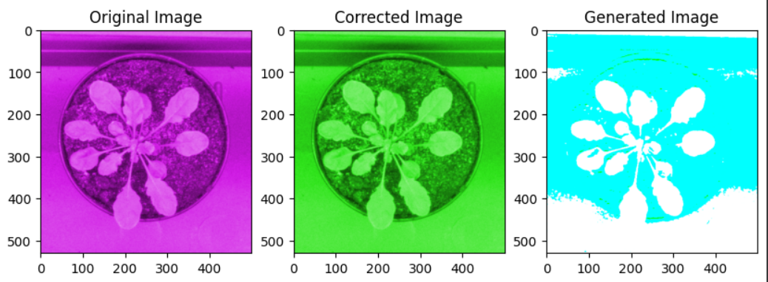
Result

Slide 23
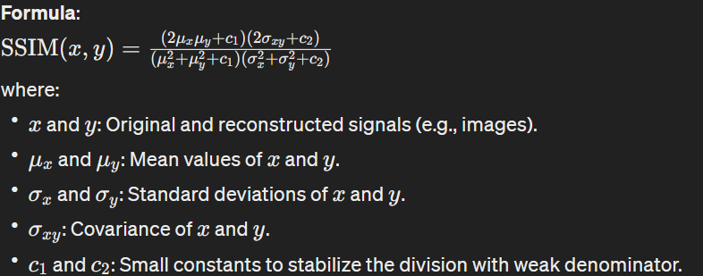

Evaluation metric
Structural Similarity Index (SSIM) –
SSIM is a metric that measures the similarity between two signals (e.g. images) in terms of luminance, contrast, and structure.

Slide 24
Evaluation metric
The Learned Perceptual Image Patch Similarity (LPIPS) metric is employed to measure the perceptual similarity between the original and the color-corrected images.
LPIPS computes the similarity between two images by measuring the distance between their deep embeddings, which are obtained from pre-trained classic neural networks such as VGG (Visual Geometry Group) and AlexNet.

Slide 25
Work plan
Model Loading: The code loads a Unet model architecture, which is a convolutional neural network commonly used for image segmentation tasks.
Image Processing: It reads an input image, converts it to the appropriate format, and prepares it for segmentation.
Segmentation Iteration: The code iteratively applies the UNet model to the input image, updating the segmentation result in each iteration until a stopping condition is met (e.g., a minimum number of labels).
Post-processing: After segentation, the code computes additional metrics such as mean image and greenness measures based on the segmented regions.
Visualization and Saving: Finally, the code visualizes the original image, segmentation result, mean image, greenness measures, and other relevant information, saving the visualization to a specified directory.

Slide 26
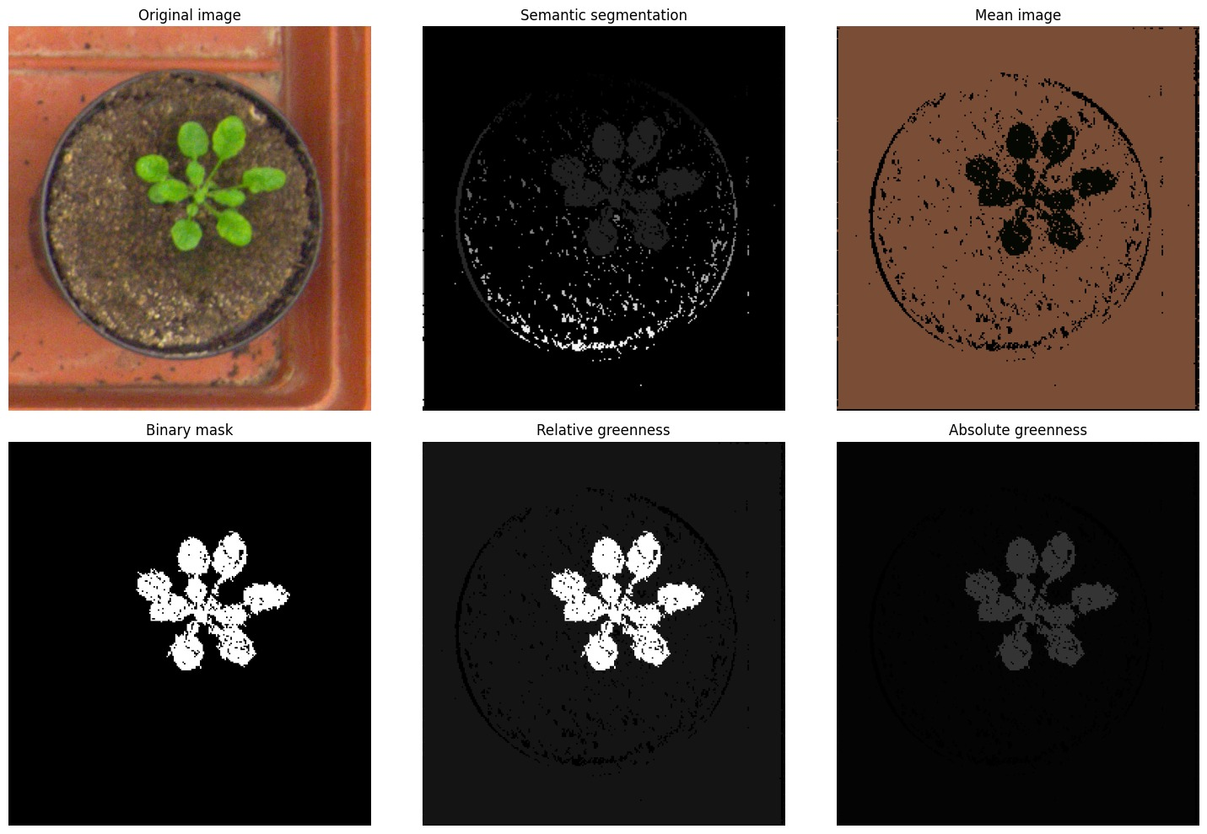
Results

Slide 27
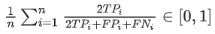


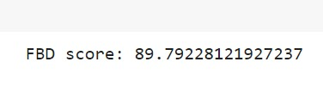
Evaluation metrices
FOREGROUND – BACKGROUND DICE(FBD)
It measures the similarity between the foreground (object of interest) regions in the predicted segmentation and the ground truth segmentation.
Calculated by --
Ground truth mask predicted mask

Slide 28
Future work
Enhance efficiency with heuristic stopping criteria and pre-trained weight initialization.
Explore self-supervised instance-level leaf segmentation using distance transform and mask integration.
Anticipate advancements in generic object segmentation and representation learning.

Slide 29
WORK CARRIED OUT
https://colab.research.google.com/drive/1ijtuZPgUtt7SX--5FudNuJD1wk916IQB?usp=sharing

Slide 30
Conclusion
The objective of the project is to introduce a self-supervised leaf segmentation framework that does not require annotated training data to segment leaf areas from the background in difficult illumination situations.
The pixel-wise label assignment in the suggested self-supervised semantic segmentation model is updated and improved iteratively. From the obtained results ,we can infer and find time it takes to segment an image of 512x512 pixels in our system.

Slide 31
References
Mishra, Anand Muni, Prabhjot Kaur, Mukund Pratap Singh, and Santar Pal Singh. "A self-supervised overlapped multiple weed and crop leaf segmentation approach under complex light condition." Multimedia Tools and Applications (2024): 1-26.
Li, Yinglun, Xiaohai Zhan, Shouyang Liu, Hao Lu, Ruibo Jiang, Wei Guo, Scott Chapman et al. "Self-supervised plant phenotyping by combining domain adaptation with 3D plant model simulations: application to wheat leaf counting at seedling stage." Plant Phenomics 5 (2023): 0041.
Minervini, Massimo, Andreas Fischbach, Hanno Scharr, and Sotirios A. Tsaftaris. "Finely-grained annotated datasets for image-based plant phenotyping." Pattern recognition letters 81 (2016): 80-89.

Slide 32
References
He, Hongjie, Hongzhang Xu, Ying Zhang, Kyle Gao, Huxiong Li, Lingfei Ma, and Jonathan Li. "Mask R-CNN based automated identification and extraction of oil well sites." International Journal of Applied Earth Observation and Geoinformation 112 (2022): 102875.
Ogidi, Franklin C., Mark G. Eramian, and Ian Stavness. "Benchmarking Self-Supervised Contrastive Learning Methods for Image-Based Plant Phenotyping." Plant Phenomics 5 (2023): 0037.
Ronneberger, Olaf, Philipp Fischer, and Thomas Brox. "U-net: Convolutional networks for biomedical image segmentation." In Medical Image Computing and Computer-Assisted Intervention–MICCAI 2015: 18th International Conference, Munich, Germany, October 5-9, 2015, Proceedings, Part III 18, pp. 234-241. Springer International Publishing, 2015.

Slide 33
THANK YOU !

